Slide 1
Disclaimer
This training resource was developed to be used with the CZ ID platform
In October, 2026, stewardship of CZ ID transitioned to UCSF and the platform was renamed to SeqtoID
These training materials are not being actively maintained and may not reflect differences between CZ ID and SeqtoID, subsequent changes to the platform, or current methods and best practices in metagenomic sequencing and analysis

Slide 2

Background models
Rapid Response – Updated Sept 2026
Notes:
Slides updated 07/02/2024

Slide 3


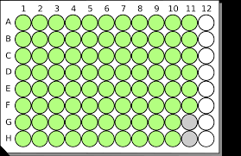



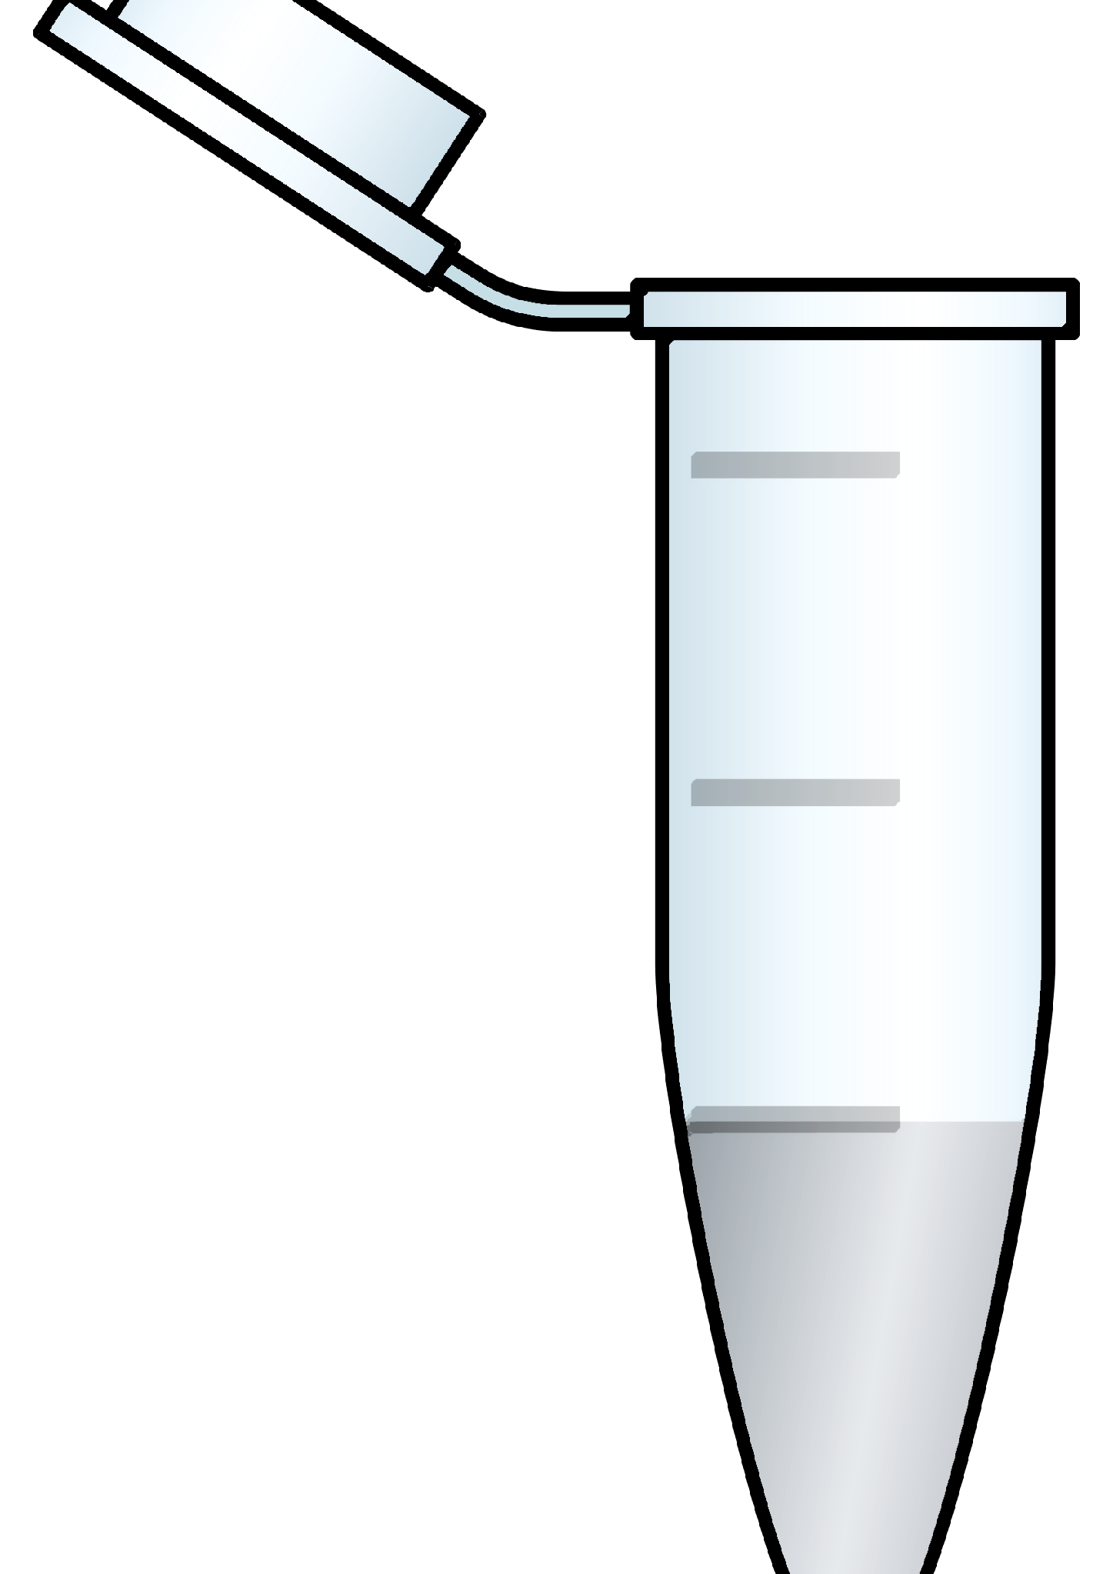
Contamination will happen!
Reagents
Lab setting
Staff/subjects
Sampling
Internal
Contamination
(cross-contamination)
External Contamination
Notes:
There are multiple opportunities for contamination during sample processing and sequencing.

Slide 4
Contamination can lead to inaccurate data interpretation
Falsely inflates within-sample diversity
Obscures differences between samples
Interferes with comparisons across studies

Slide 5
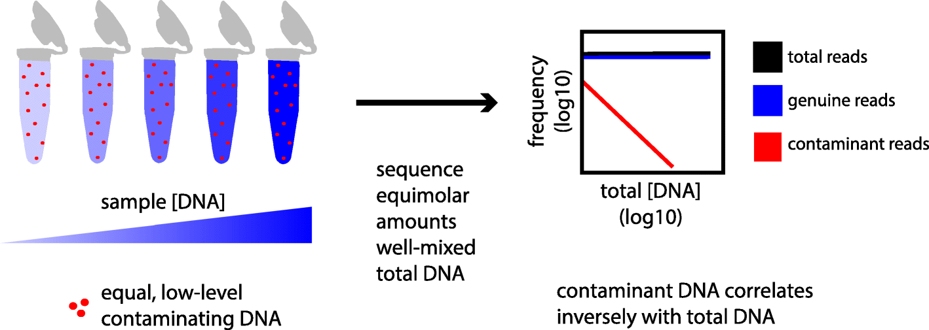
Contamination disproportionately affects low-biomass samples
Davis et. al., 2018

Slide 6
Water controls can help
‘Blanks’ such as water controls can help identify both internal and external contaminants
Water controls should be processed the same way as the samples, using the the same reagents
  Have at least 2 water controls, but the more the better!

Slide 7
Background model
Used to calculate relative abundance of the taxa found in negative controls
2 types of background models based on relative abundance metric:
  Standard:
    Uses the reads per million (rpm) as the metric of relative abundance.
  Mass normalized:
    Uses total ERCC reads to normalize taxon reads.
    Only available when samples have been spiked with ERCCs.
Notes:
Mass normalized is more sensitive so use it when you can (ERCC)

Slide 8
Background model enables Z-score calculation
Z-score
  Measurement that describes a value's relationship to the mean of a group of values
    How does the abundance of a taxon in a sample compare to its mean abundance in negative controls?

Slide 9
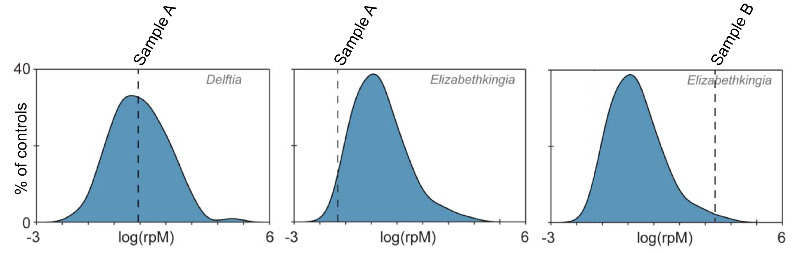
Background distribution
overlaid with sample taxa abundance
Abundance in potentially infectious sample
Distribution of abundance in controls
Notes:
Purpose of the background model is to create a distribution of that taxa in the negative controls
Then see where the sample falls within that distribution

Slide 10
Background model enables Z-score calculation
Z-score
  Measurement that describes a value's relationship to the mean of a group of values
    How does the abundance of a taxon in a sample compare to its mean abundance in negative controls?
  It is measured in terms of standard deviations from the mean
Notes:
Go to next slide for equation discussion

Slide 11
x = taxon abundance in sample
µ = taxon mean abundance in negative controls (background model)
𝝈 = standard deviation of taxon abundance in negative controls (background model)
𝛧-score linear scale:
0
Notes:
Transition: what happens when the sample has the same abundance as the background (negative controls)? See next slide for answer

Slide 12
x = taxon abundance in sample
µ = taxon mean abundance in negative controls (background model)
𝝈 = standard deviation of taxon abundance in negative controls (background model)
No difference
𝛧 = 0
Notes:
Think through: What happens if it’s higher in your negative control? (See next slide for answer)

Slide 13
x = taxon abundance in sample
µ = taxon mean abundance in negative controls (background model)
𝝈 = standard deviation of taxon abundance in negative controls (background model)
No difference
𝛧 < 0
𝛧 = 0
Taxa more abundant in negative controls than in samples
Notes:
Think through: What happens if it’s higher in your sample? (See next slide for answer)

Slide 14
x = taxon abundance in sample
µ = taxon mean abundance in negative controls (background model)
𝝈 = standard deviation of taxon abundance in negative controls (background model)
No difference
𝛧 < 0
𝛧 = 0
𝛧 > 0
Taxa more abundant in negative controls than in samples
Taxa more abundant in samples than negative controls

Slide 15
x = taxon abundance in sample
µ = taxon mean abundance in negative controls (background model)
𝝈 = standard deviation of taxon abundance in negative controls (background model)
Only in control
No difference
Only in sample
-100
0
100
Taxa more abundant in negative controls than in samples
Taxa more abundant in samples than negative controls

Slide 16
Use Z-score filter after applying background model
Start with taxa with Z-scores > 1
Only in control
Only in sample
-100
0
100
Taxa more abundant in negative controls than in samples
Taxa more abundant in samples than negative controls

Slide 17
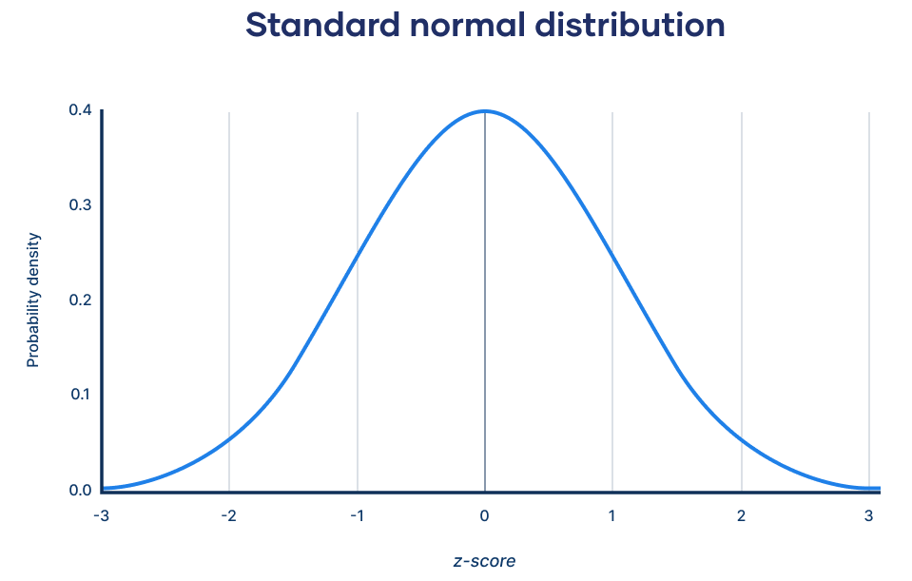
Use Z-score filter after applying background model
Start with taxa with Z-scores > 1

Slide 18
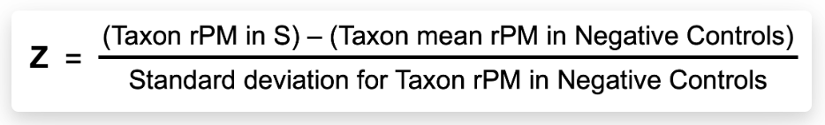
Calculating Z-score
Mass normalized (mass_norm) Z-score calculation:
Standard Z-score calculation for sample “S”:
Notes:
Actual equations used in CZ ID

Slide 19
Additional controls
Controls can also be used to create a background model to identify pathogens of interest (for example, cases vs controls)
Sample controls can also be used to identify contaminants from sampling, but can be difficult to come by
Background models can be applied to the sample report and the heatmap

Slide 20
Let’s make a background model!
Next Slides: DL8-I_CZ ID Heatmap for Illumina

Slide 21
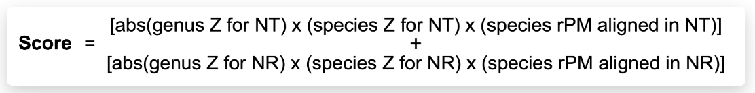
Aggregate Score (Score)
The Z-score is used to calculate an aggregate score (Score). The aggregate score is an empirical heuristic for ranking microbial matches by combining relative abundance and Z-score information at the species and genus levels. The aggregate score is calculated as follows:
If a taxon has a high aggregate score it indicates that a high abundance of reads matched to that taxon in the NT and/or NR database, while being less prevalent in the selected background model.

